Slide 1



ECOREVOLVE
Revolutionizing Waste Management and Recycling
Presented By team:
Catalysts
Team Members :
Shreya Gupta (2200290100157) (CSE)
Gaurav Gupta (2200290120070) (CS)

Slide 2



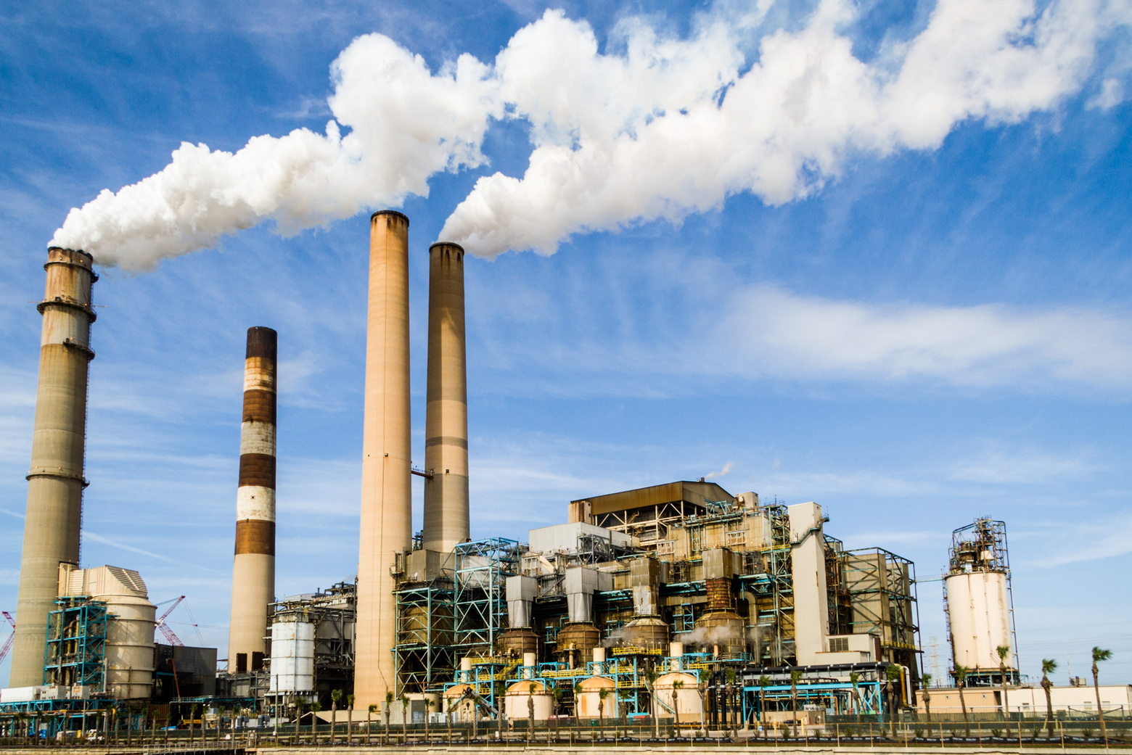
MISSION
Revolutionize waste management through technology and collaboration, fostering sustainability and a circular economy.
OVERVIEW
Our project Ecorevolve aims to Revolutionizing Waste Management and Recycling process through an AI powered plateform connecting industries and waste management for efficient resource exchange and tranforms industrial waste into valuable raw materials for use in diverse industries, fostering sustainability,reducing environmental impact, and promoting a circular economy.

Slide 3

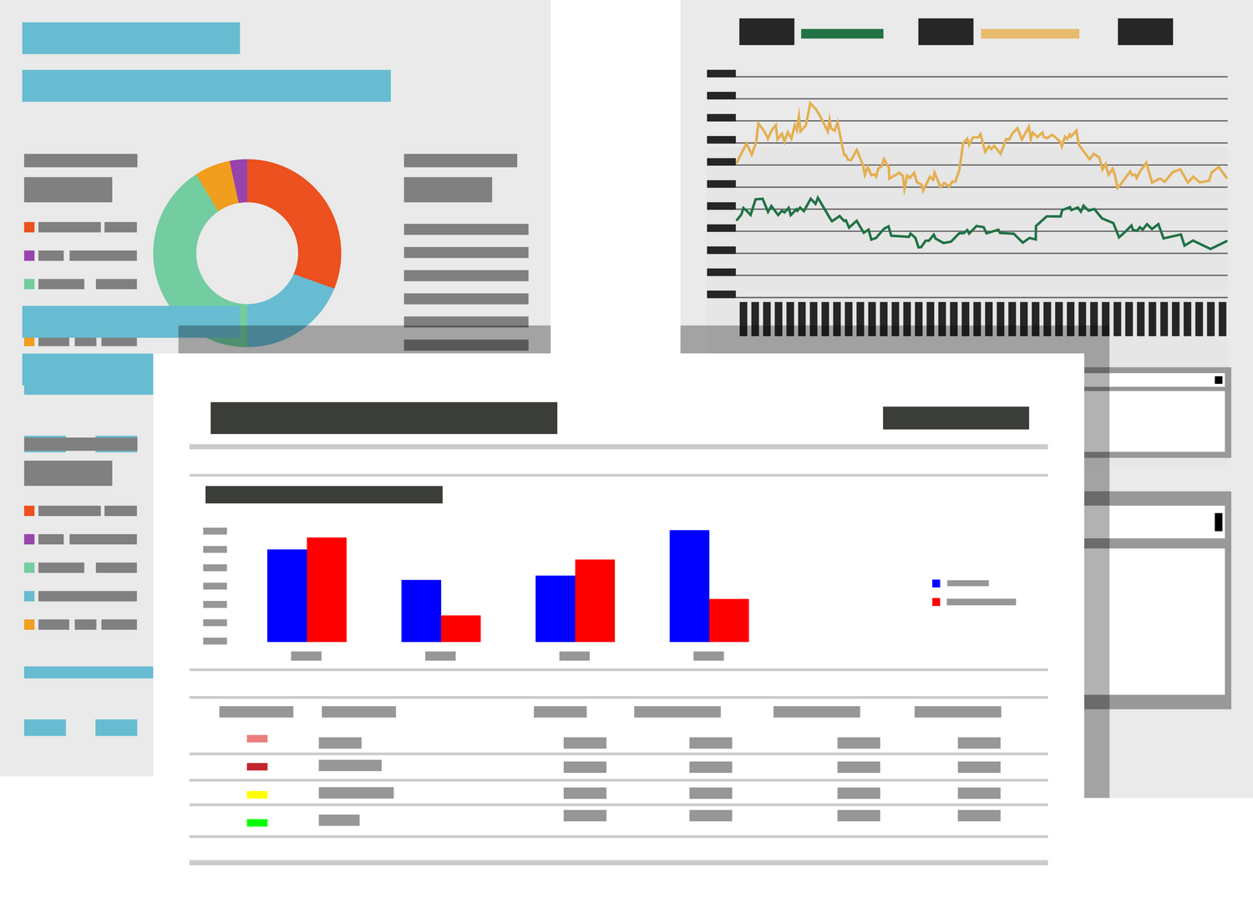



FEATURES
AI-Powered Resource Exchange Platform
Efficient Communication Tools
Feedback and Ratings System
Notification System
User Profiles and Dashboard
Public Showcase and Tours
Recycling Center Locator
Data Analytics

Slide 4








ML MODEL
Intelligent Waste Search
Waste Utilization Suggestions
Waste Recycling Optimization
Environmental Impact Assessment
Predictive Waste Trends
User Behavior Analytics
Collaborative Waste Solutions

Slide 5








Technology Stack
1. Google Maps API
2. AWS
3. React.js
4. Node.js
5. Express.js
6. MongoDB
7. AI-powered Insights

Slide 6
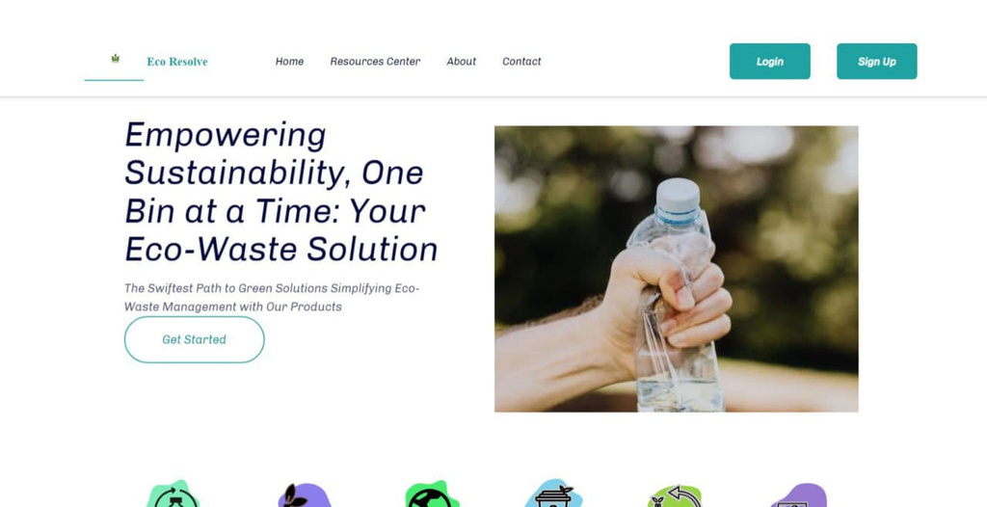


Try Our
Great Website
Website Interface
Speed

Slide 7




Working Process
1
2
3
4
5
step 1
step 2
step 3
step 4
step 5
User registration and Profile Creation
Waste Listing
Ai-Powered Waste Analysis
Recycling Centre Locator
Collaborative Recycling Solutions
6
step 6
Feedback and Rating system
11
10
9
8
7
step 11
step 10
step 9
step 8
step 7
Supplt Chain Integration
Environmental impact Assessment
Data Analysis for Recycling Trends
Notification System
Efficient communication Tools
step 12
12
Public Showcase and Tours
13
14
15
step 13
step 14
step 15
Educational Initiatives
Global Expansion
Continuous Improvement and Innovation

Slide 8







SDG’s

Slide 9

Benefits and Impacts
Environmental Impacts
Sustainable Practices
Collaboration and Networking
Reduced Waste
Circular Economy
Lower Carbon footprint
Industry Collaboration
Global Impact
Economic Benefits
Technological Innovation

Slide 10



Conclusion
EcoRevolve is a groundbreaking solution combining technology and sustainability. By reducing waste, promoting a circular economy, and fostering industry collaboration, it aligns with global sustainability goals. The integration of AI and Google technologies enhances efficiency, making it a catalyst for positive change. As we move forward, EcoRevolve invites collaboration to drive meaningful and scalable impact in waste management. Thank you for your attention and commitment to a more sustainable future with EcoRevolve.

Slide 11

THANK YOU

